Slide 1

Intel® Unnati Industrial Training - Summer 2023 Problem Statement- Conquering Fashion MNIST Dataset by CNN using Computer Vision
Submitted By –
Team Name - Byte Cruncher
Team Member Name – Vivek Kumar Singh
Branch- B.Tech CSE with AI & ML (Section -2) Semester- IV
Admission No. – 21SCSE1180163
Date of Submission : 09.06.2023
College Mentor – Mr. Gopal Chandra Jana
Industry Mentor – Mohan Nikam

Slide 2
Overview
Introduction
Why/Motivation Behind The Problem
Prior Work/Background
Our Approach
Description Of Dataset
Dataset preprocessing
Result
References
Links to Solution

Slide 3
Introduction
Deep Learning has been employed extensively and has shown excellent results in a variety of fields over the past few years, including computer vision, large data, automatic speech recognition, and natural language processing. CNN is a typical deep neural network architecture. CNN is a multi-layer perceptron neural network that is trained using the neural network back-propagation technique that extracts properties from the input data. From a huge amount of input (pictures), CNN can learn intricate, high-dimensional, non-linear mappings. CNN also provides a fantastic categorization average for photographs. The primary benefits of CNN are that it extracts the prominent features that never change and that it is invariant to shifting, scaling, and distortions of input data (pictures). Labels and classes are distorted in a similar way, but CNN does not suffer from these flaws.
Fashion classification, in which labels that describe the type of clothing are assigned to the photographs, is one of the most difficult multi-class classification problems. The diversity of the clothing attributes and the extensive level of clothing categorization both contribute to the challenge of this multi-class fashion classification problem. Different labels and classes have comparable characteristics as a result of this intricate depth.
Figure 1: CNN Architecture

Slide 4
Why/Motivation behind the problem
The motivation behind the Fashion MNIST dataset can be summarized as follows:
Realistic representation: Fashion MNIST provides a more realistic and challenging representation of image classification tasks, as it deals with a broader range of object categories, representing common fashion items.
Relevance to industry: Fashion and apparel classification is an important application in various industries, including e-commerce, retail, and fashion design. Developing accurate and efficient classification models can have practical implications in inventory management, recommendation systems, and quality control.
Algorithm development and comparison: The Fashion MNIST dataset serves as a standard benchmark for evaluating and comparing different machine learning algorithms and techniques in the field of computer vision. It enables researchers and practitioners to measure the performance of their models and to track advancements in the field.
Educational purposes: Fashion MNIST is also used as an educational tool to introduce students and newcomers to the field of machine learning and image recognition. Its similarity to the MNIST dataset allows for easy transition and comparison while providing a more engaging and relevant context.
Overall, the motivation behind the problem of classification of the Fashion MNIST dataset lies in the need for a more challenging and realistic benchmark dataset for image classification tasks, specifically in the domain of fashion and apparel recognition.

Slide 5
Prior Work/Background
There has been extensive prior work on the classification of the Fashion MNIST dataset. Researchers and machine learning practitioners have employed various techniques and algorithms to achieve high accuracy on this dataset. Here are some notable examples of prior work in this area:
Transfer Learning: Transfer learning techniques have been explored to leverage pre-trained models trained on larger datasets like ImageNet and apply them to the Fashion MNIST dataset. By fine-tuning the pre-trained models or using them as feature extractors, researchers have achieved improved performance on Fashion MNIST.
Ensemble Methods: Ensemble methods, such as bagging and boosting, have been employed to combine predictions from multiple models and improve classification accuracy on the Fashion MNIST dataset. Techniques like random forests, gradient boosting, and stacking have been utilized to create ensemble models.
Support Vector Machines (SVM): SVMs have been applied to the Fashion MNIST dataset by transforming the image data into appropriate feature vectors. Kernel tricks and different SVM variants have been used to classify the images into different fashion categories.
K-Nearest Neighbors (KNN): KNN algorithms have been utilized for the Fashion MNIST dataset by measuring the distance between images and classifying them based on the nearest neighbors in the feature space. Different distance metrics and value of k have been experimented to improve classification performance.
Deep Learning Architectures: Besides CNNs, researchers have explored other deep learning architectures like deep belief networks (DBNs), recurrent neural networks (RNNs), and generative adversarial networks (GANs) for the classification of Fashion MNIST. These architectures have shown promising results in achieving high accuracy.
Data Augmentation: Data augmentation techniques, such as rotation, scaling, flipping, and adding noise, have been used to artificially increase the size of the training set and improve the generalization of models on the Fashion MNIST dataset.
These are just a few examples of the prior work done in the classification of the Fashion MNIST dataset. The field of image recognition and machine learning constantly evolves, and researchers continue to explore novel approaches and techniques to enhance the accuracy and efficiency of classification models on this dataset.

Slide 6
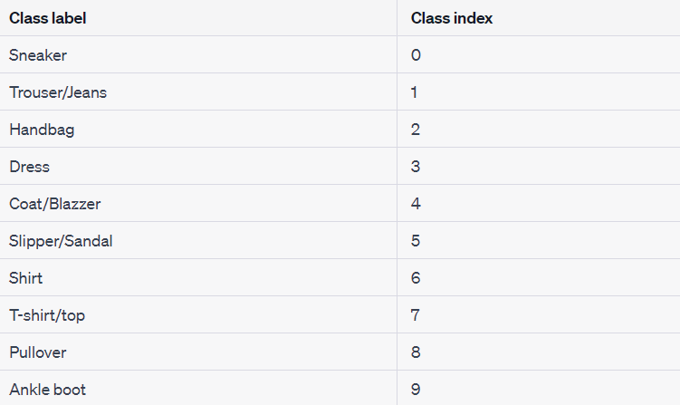
Our Approach
Description of dataset
The Fashion MNIST dataset consists of 70,000 grayscale pictures of apparel that are broken down into 10 categories, as indicated in Table 1: Sneaker, Trouser/Jeans, Handbag, Dress, Coat/Blazzer, Slipper/Sandal, Shirt, T-shirt/top, Pullover, and Ankle Boot. There are 784 features total for each image, which is a 28x28 pixel square. A model must be trained using the provided training set, which consists of 60,000 photos, and its performance must be assessed using the test set, which consists of 10,000 images. The test photographs should be able to be classified by the model into one of the 10 fashion categories.
Each image has dimensions of 28 pixels in height and 28 pixels in width, for a total of 784 pixels. Each pixel has a single pixel value that describes its lightness or darkness, with greater values signifying darker pixels. This pixel value is an integer between 0 and 255. There are 785 columns in both the training and test data sets. The class labels in the first column, which stand in for the item of clothing, are seen above. The corresponding image's pixel values are located in the remaining columns.
Figure 2: Fashion-MNIST Dataset

Slide 7
Our Approach
Dataset preprocessing
I. Loading the Dataset:
The first step in preprocessing the Fashion MNIST dataset is to load the dataset into memory. The dataset is available in the form of separate training and testing sets, typically stored in a suitable file format such as CSV or binary files. We load the dataset using a suitable library or framework such as NumPy or Pandas, ensuring that the data is correctly read and organized for further processing.
II. Data Cleaning:
Before proceeding with any further preprocessing steps, it is crucial to check the dataset for any missing or corrupted data. This step helps in identifying and handling any anomalies that might affect the subsequent analysis. Fortunately, the Fashion MNIST dataset is relatively clean and well-maintained, and thus, no specific data cleaning steps are required.
III. Normalization:
Normalization is a standard preprocessing step that aims to scale the input features to a common range. This step is particularly important in computer vision tasks, as it helps improve the convergence of optimization algorithms. For the Fashion MNIST dataset, normalization is performed by dividing the pixel values of each image by 255. This process ensures that all pixel values are within the range [0, 1], making them suitable for further processing.

Slide 8
Our Approach
IV. Reshaping:
The Fashion MNIST dataset comes in the form of grayscale images with a resolution of 28x28 pixels. However, many machine learning algorithms and frameworks expect input data to be in a specific shape, such as a flattened vector or a specific tensor shape. Therefore, we reshape each image in the dataset to a 1D vector of size 784 (28x28). This transformation allows the images to be compatible with a wide range of machine learning models and algorithms.
V. Label Encoding:
The labels in the Fashion MNIST dataset are represented as integers ranging from 0 to 9, indicating the corresponding fashion category. To make the labels compatible with
machine learning algorithms, it is necessary to perform label encoding. This step converts the integer labels into a suitable format, such as one-hot encoding or ordinal encoding, depending on the specific requirements of the algorithm being used.
VI. Train-Validation Split:
To evaluate the performance of machine learning models accurately, it is common practice to split the dataset into separate training and validation sets. The training set is used to train the model, while the validation set helps in assessing the model’s performance and tuning hyperparameters. Typically, a split of around 80% training and 20% validation is used for the Fashion MNIST dataset. After splitting the training dataset, we get 48000 images for training and 12000 images for validation important in computer vision tasks, as it helps improve the convergence of optimization algorithms. For the Fashion MNIST dataset, normalization is performed by dividing the pixel values of each image by 255. This process ensures that all pixel values are within the range [0, 1], making them suitable for further processing.

Slide 9
Our Approach
CNN:
Convolutional neural networks are a subset of deep feed-forward artificial neural networks that are mostly employed in the processing of images for purposes including segmentation, classification, and other functions. Convolutional, pooling, and fully-connected layers are the three types of layers it has. Convolution, in the context of CNNs, refers to the process of applying a set of filters or kernels to the input image. Each filter detects specific patterns or features, such as edges or textures, by convolving it across the image. This results in the extraction of relevant features and the creation of feature maps that highlight the presence of these patterns in different regions of the image.
Below is the architecture of my final CNN model. It has 2 convolutional layers, 2 max. Pool layers, 2 dropout layers, 2 fully connected (dense) layer and 1 output (SoftMax) layer. Apart from these, it also has a flatten layer whose purpose is just to ‘flatten’ the output, i.e. convert a 2-D output to a 1-D output (which is then fed to the dense layer).
CONV layers compute the output of neurons that are connected to local regions in the input, each computing a dot product between their weights and a small region to which they are connected in the input volume. We used 32 filters in the first layers of all architectures. As a result, we have a volume of [26x26x32] in the output. The activation function RELU is used in all of the conv layers.
MAX POOL layers perform a down sampling operation along spatial dimensions (width, height), resulting in a volume of [13x13x32] from the first layer (Max1).
The fully-connected (FC) layers will calculate class scores. The RELU activation function is used in the two FC layers, while the SoftMax activation function is used in the last layer.

Slide 10
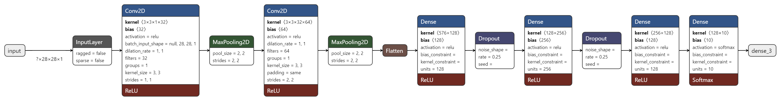
Our Approach
Figure 3: Final CNN Model Architecture
Tensorflow
You may design extremely adaptable CNN networks for computer vision problems using the open source TensorFlow framework.
Data from deep learning is represented via tensors. They are multidimensional arrays that are used to store different dataset dimensions. A feature is the term used to describe each dimension. As an illustration, a 3-dimensional tensor is used to depict a cube that stores data across X, Y, and Z accesses. Tensors can
contain very high dimensionality, with hundreds of dimensions of characteristics that are frequently utilized in deep learning applications.
Keras
A robust and user-friendly open-source Python library for creating and analyzing deep learning models is called Keras. With only a few lines of code, you can define and train neural network models using this component of the TensorFlow library. Setting up your environment, installing Keras and Tensorflow, importing libraries and modules, loading picture data from MNIST, and preprocessing input data for Keras are all necessary steps in the construction of a CNN using Keras. Pixels in photos are used by convolutions to recognize and categorize them.

Slide 11
Result
The results of training and cross validation (validation) for a CNN model that I first tested out without using any regularization techniques are shown in the Table 1.
The results below demonstrate that deep learning models have a considerable tendency to overfit (perform better on training datasets than on validation/test datasets).
The model is overfitted as training accuracy is 96% and test accuracy is 91%.
I used the regularization approach known as “Dropout” to address the model overfitting issue, and I also added a few more max. pool layers. In the section under “CNN Model Architecture,” the architectural diagram for this CNN model is displayed above. The outcomes for the same are listed below.
A training accuracy value of 92% and test accuracy of 90% confirms that model is performing fine and there is no overfitting. Thus, this is our final CNN model.
Model | Model Architecture | Training Accuracy | Validation Accuracy | Test Accuracy
CNN | 1 Convolutional layer, 1 max pool layer, 1 fully connected layer, 1 output layer | 96.12 | 90.46 | 91.07
Table 1 : Results of CNN model without applying Regularization
Model | Model Architecture | Training Accuracy | Validation Accuracy | Test Accuracy
CNN | 2 Convolutional layer, 2 max pool layer, 2 fully connected layer, 2 dropout layer, 1 output layer, Optimizer- adam, Loss- Sparse Categorical Crossentropy | 92.13 | 90.44 | 90.01
Table 2 : Results of the CNN model with regularization (dropout) applied

Slide 12
Result
Below are the plots for ‘Accuracy’ and ‘Loss’ for training and validation(test) phases for this final CNN model.
Figure 3: ‘Accuracy’ plot for CNN Model for training and validation(test) dataset
Table 2: Classification Report
Figure 4: ‘Loss’ plot for CNN Model for training and validation(test) dataset

Slide 13
References
https://keras.io/api/
https://www.tensorflow.org/guide/keras
https://docs.openvino.ai/
https://opencv.org/
https://towardsdatascience.com/
Links to Solution
Code/Results Github link – https://github.com/svivek2002/intelunnati_ByteCruncher.git
Model link - https://jupyter.oneapi.devcloud.intel.com/user/u194786/lab/workspaces/auto-s/tree/Model.ipynb

